Slide 1

Data Visualization
The Information School, UW-Madison

Slide 2
Principles of Data Visualization
Edward Tufte’s simple principles for creating data visualizations
(see Envisioning Information)
Above all else, show the data.
Maximize the data-ink ratio
Erase non-data-ink
Erase redundant data-ink
Revise and edit

Slide 3
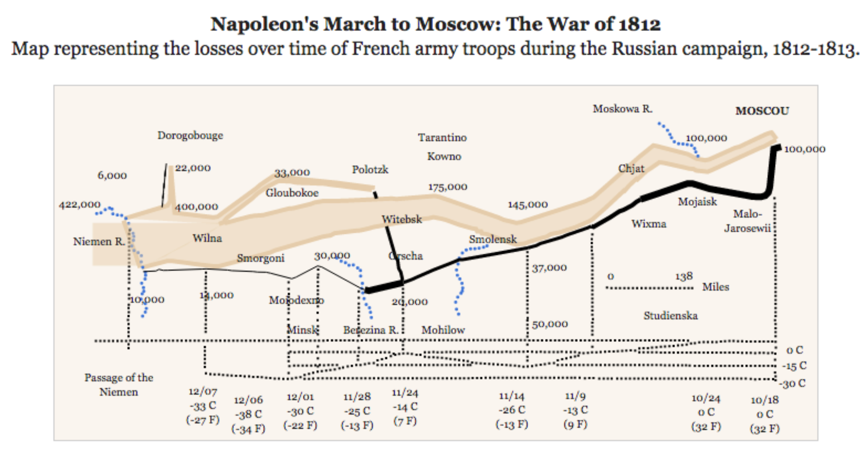
Above all else, show the data
Notes:
https://medium.com/plotly/above-all-else-show-the-data-1b8bbf05c2ae

Slide 4
Above all else, show the data
Notes:
https://medium.com/plotly/above-all-else-show-the-data-1b8bbf05c2ae

Slide 5
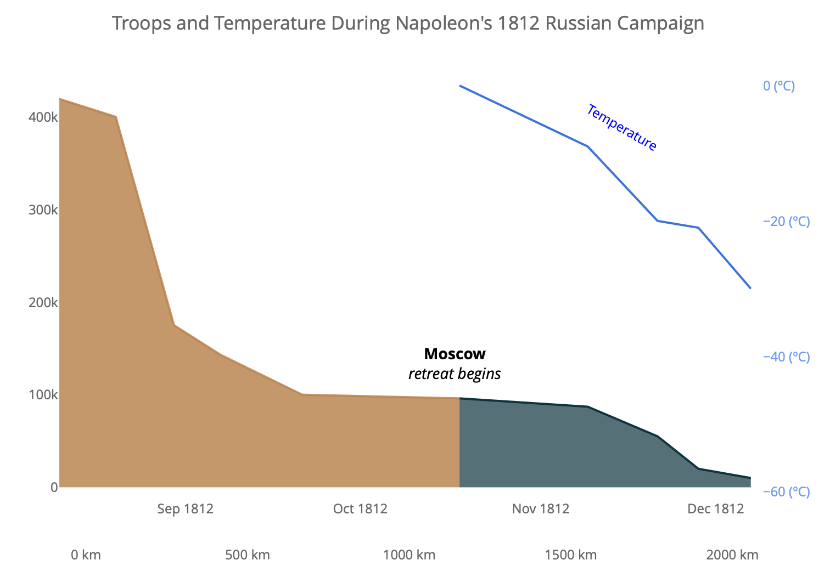
Above all else, show the data
Notes:
https://medium.com/plotly/above-all-else-show-the-data-1b8bbf05c2ae

Slide 6
Maximize data–ink ratio
Data ink - Ink that changes as the data changes
Non-redundant ink!

Slide 7
Maximize data-ink ratio
data-ink
Data-ink ratio =
Total ink used to print graphic
= Proportion of a graphic’s ink devoted to the non-redundant display of data-information.
= 1.0 – proportion of graphic that can be erased without the loss of information
Notes:
https://medium.com/plotly/above-all-else-show-the-data-1b8bbf05c2ae

Slide 8
Maximize data-ink ratio
Notes:
https://medium.com/plotly/above-all-else-show-the-data-1b8bbf05c2ae

Slide 9
Erase non-data ink
Notes:
https://medium.com/plotly/above-all-else-show-the-data-1b8bbf05c2ae

Slide 10
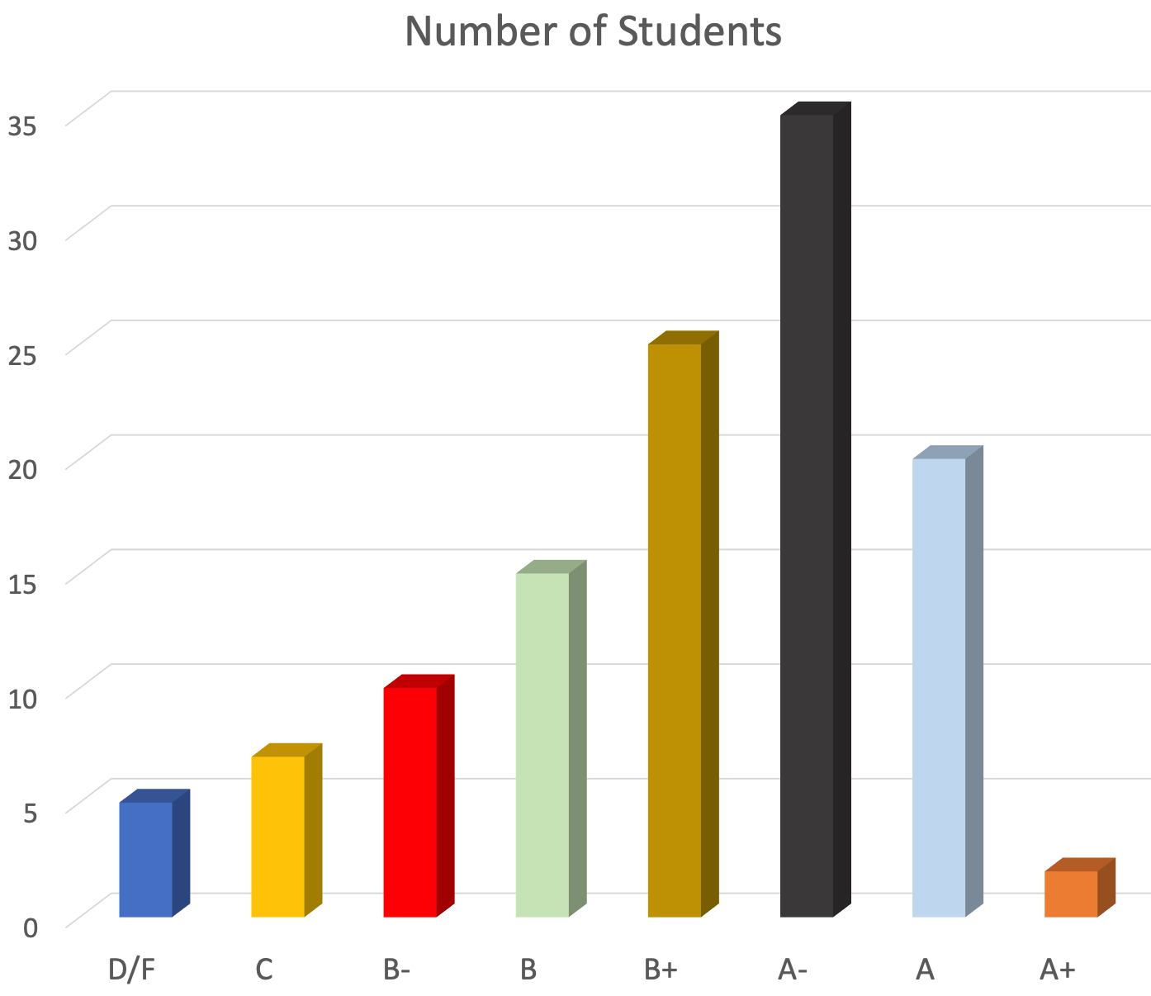
Erase redundant ink
Notes:
https://medium.com/plotly/above-all-else-show-the-data-1b8bbf05c2ae

Slide 11
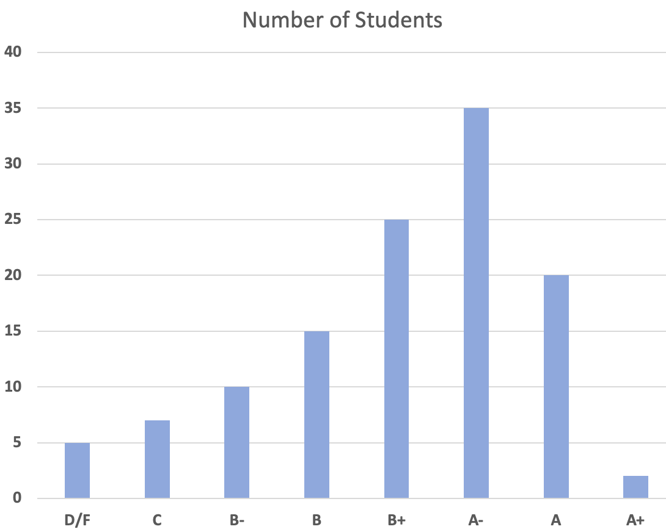
Erase redundant ink
Notes:
https://medium.com/plotly/above-all-else-show-the-data-1b8bbf05c2ae

Slide 12
How are visualizations manipulated?
Skewing the axes
Using the wrong type of charts
Adding chart junk
Misrepresenting data
Visual distortion
Notes:
https://medium.com/plotly/above-all-else-show-the-data-1b8bbf05c2ae

Slide 13
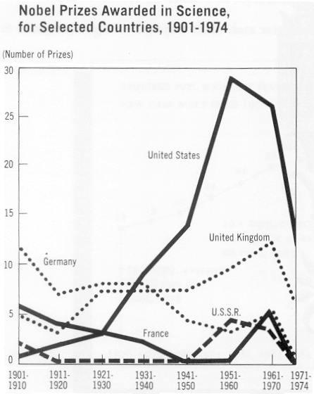
What is wrong with this graph?
Notes:
https://medium.com/plotly/above-all-else-show-the-data-1b8bbf05c2ae

Slide 14
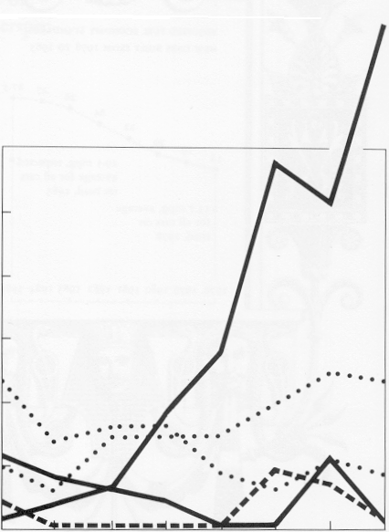
Manipulated x-axis
A graphic generates visual expectations
Deception can result from incorrect extrapolation of visual expectations
1st seven intervals are 10 years
The last interval is 4 years
Gives a false sense of decline
Notes:
https://medium.com/plotly/above-all-else-show-the-data-1b8bbf05c2ae

Slide 15
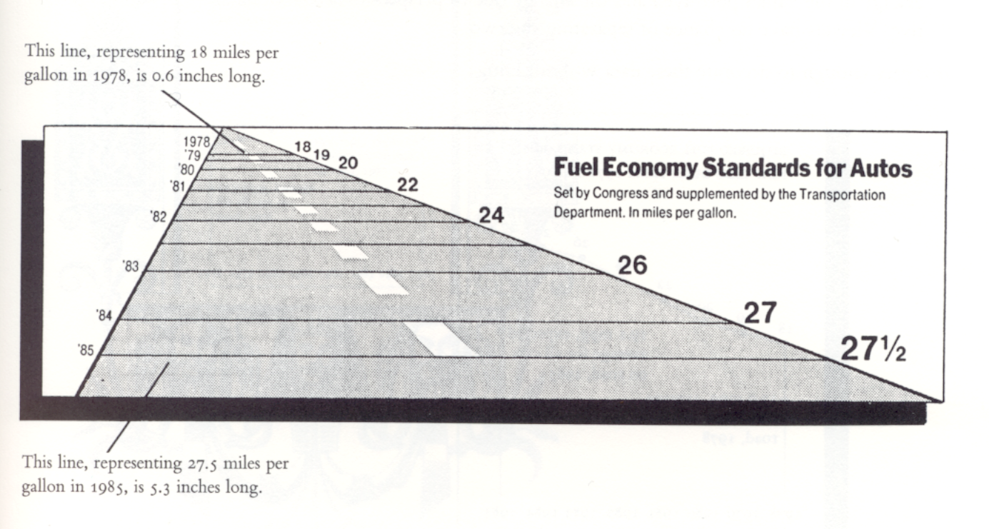
What is wrong with this graph?
Notes:
https://medium.com/plotly/above-all-else-show-the-data-1b8bbf05c2ae

Slide 16
What is wrong with this graph?
Notes:
https://medium.com/plotly/above-all-else-show-the-data-1b8bbf05c2ae

Slide 17
Graphical Distortion
Numerical Increase
18 miles/gallon in 1978 to 27.5 miles/gallon in 1985
Increase of 53% = (27.5 – 18.0)/(18.0) x 100
Graphical Increase
0.6 inches in 1978 to 5.3 inches in 1985
Increase of 783% = (5.3 – 0.6)/(0.6) x 100
Notes:
https://medium.com/plotly/above-all-else-show-the-data-1b8bbf05c2ae

Slide 18
Graphical Distortion
LIE FACTOR
Lie Factor = size of effect shown in graphic
size of effect in data
Lie Factor = 783/53 = 14.8
Notes:
https://medium.com/plotly/above-all-else-show-the-data-1b8bbf05c2ae

Slide 19
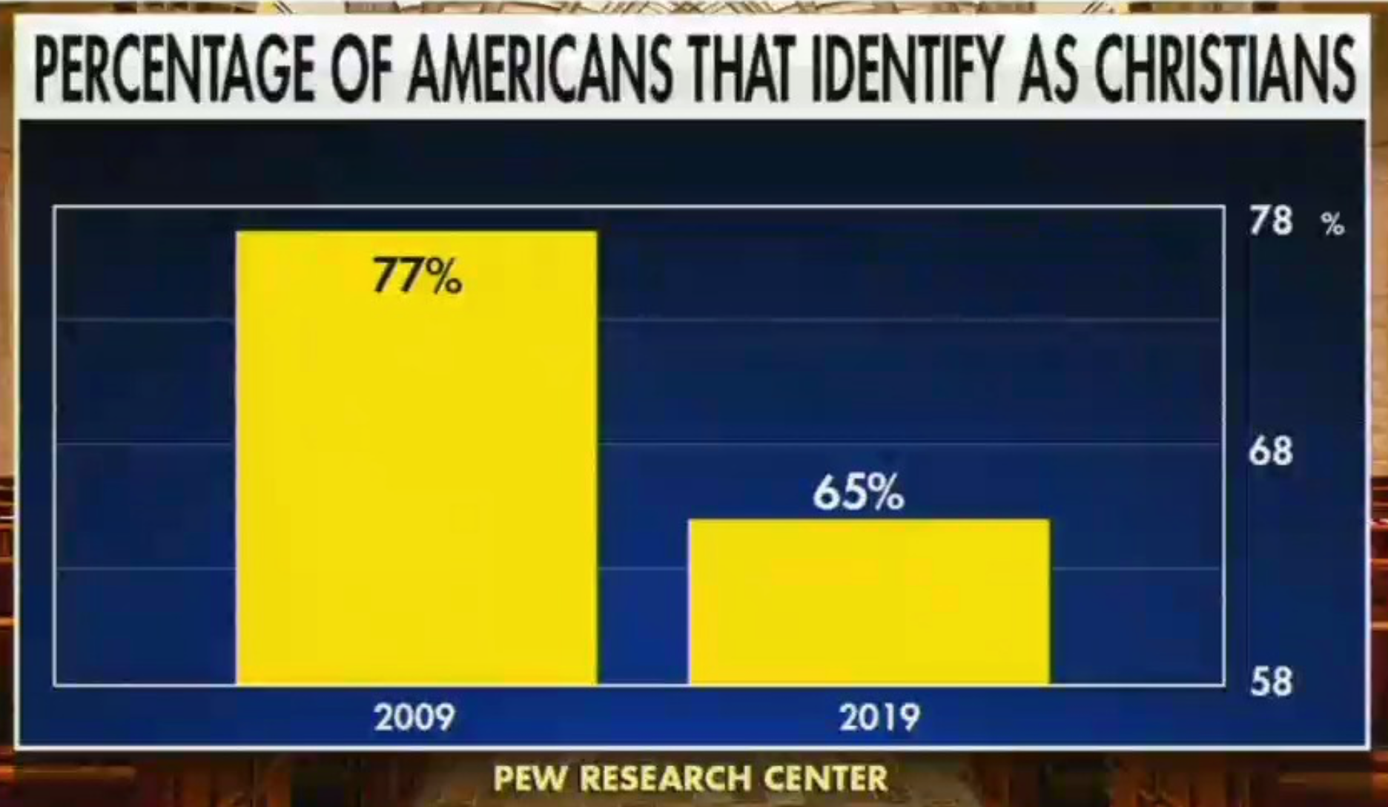
What is wrong with this graph?
Notes:
https://medium.com/plotly/above-all-else-show-the-data-1b8bbf05c2ae

Slide 20
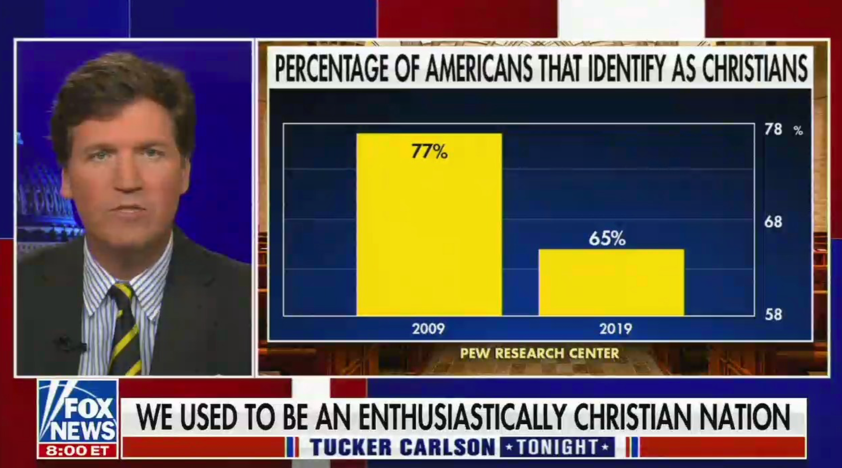
Skewed y-axis
Notes:
https://medium.com/plotly/above-all-else-show-the-data-1b8bbf05c2ae

Slide 21
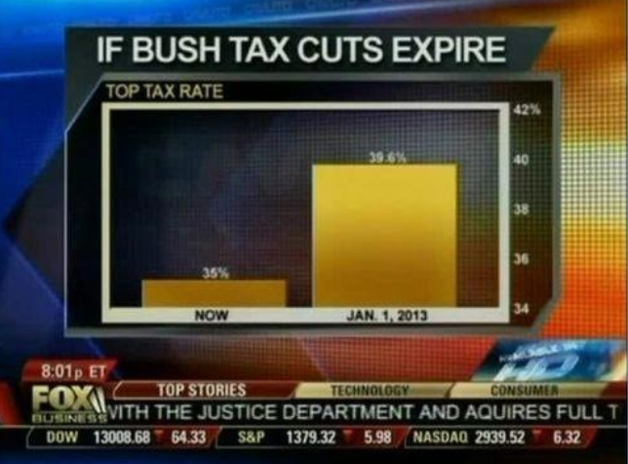
What is wrong with this graph?
Notes:
https://medium.com/plotly/above-all-else-show-the-data-1b8bbf05c2ae

Slide 22
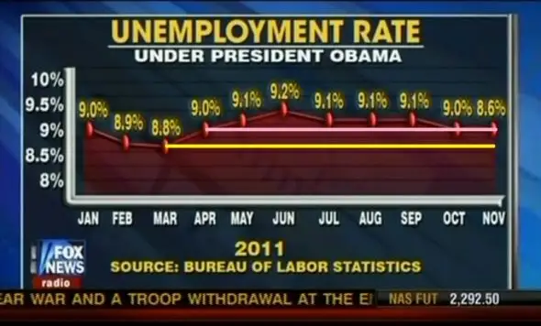
What is wrong with this graph?
Notes:
https://medium.com/plotly/above-all-else-show-the-data-1b8bbf05c2ae

Slide 23
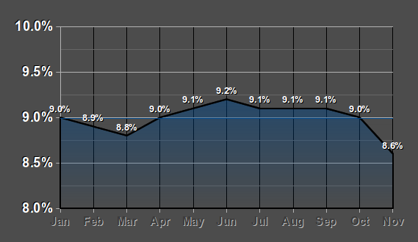
What is wrong with this graph?
Notes:
https://medium.com/plotly/above-all-else-show-the-data-1b8bbf05c2ae

Slide 24
Visualizations for Exploratory Analysis
Line Graphs and Time Series
Scatterplots and Correlations
Bar Plots, Histograms, and Distributions
Relational Plots and Multiple Variables
Grid Charts and Small Multiples
Notes:
https://medium.com/plotly/above-all-else-show-the-data-1b8bbf05c2ae

